Slide 1
Nba Season Stats Management
Open data management & the cloud

Slide 2

abstract
Aim of the project
The main objective of this project is to create a data management system of NBA season stats for team, players and coach.
This system can be used by researcher or analyst to investigate about data, apply supervised or unsupervised ML or visualize data by BI tool.

Slide 3
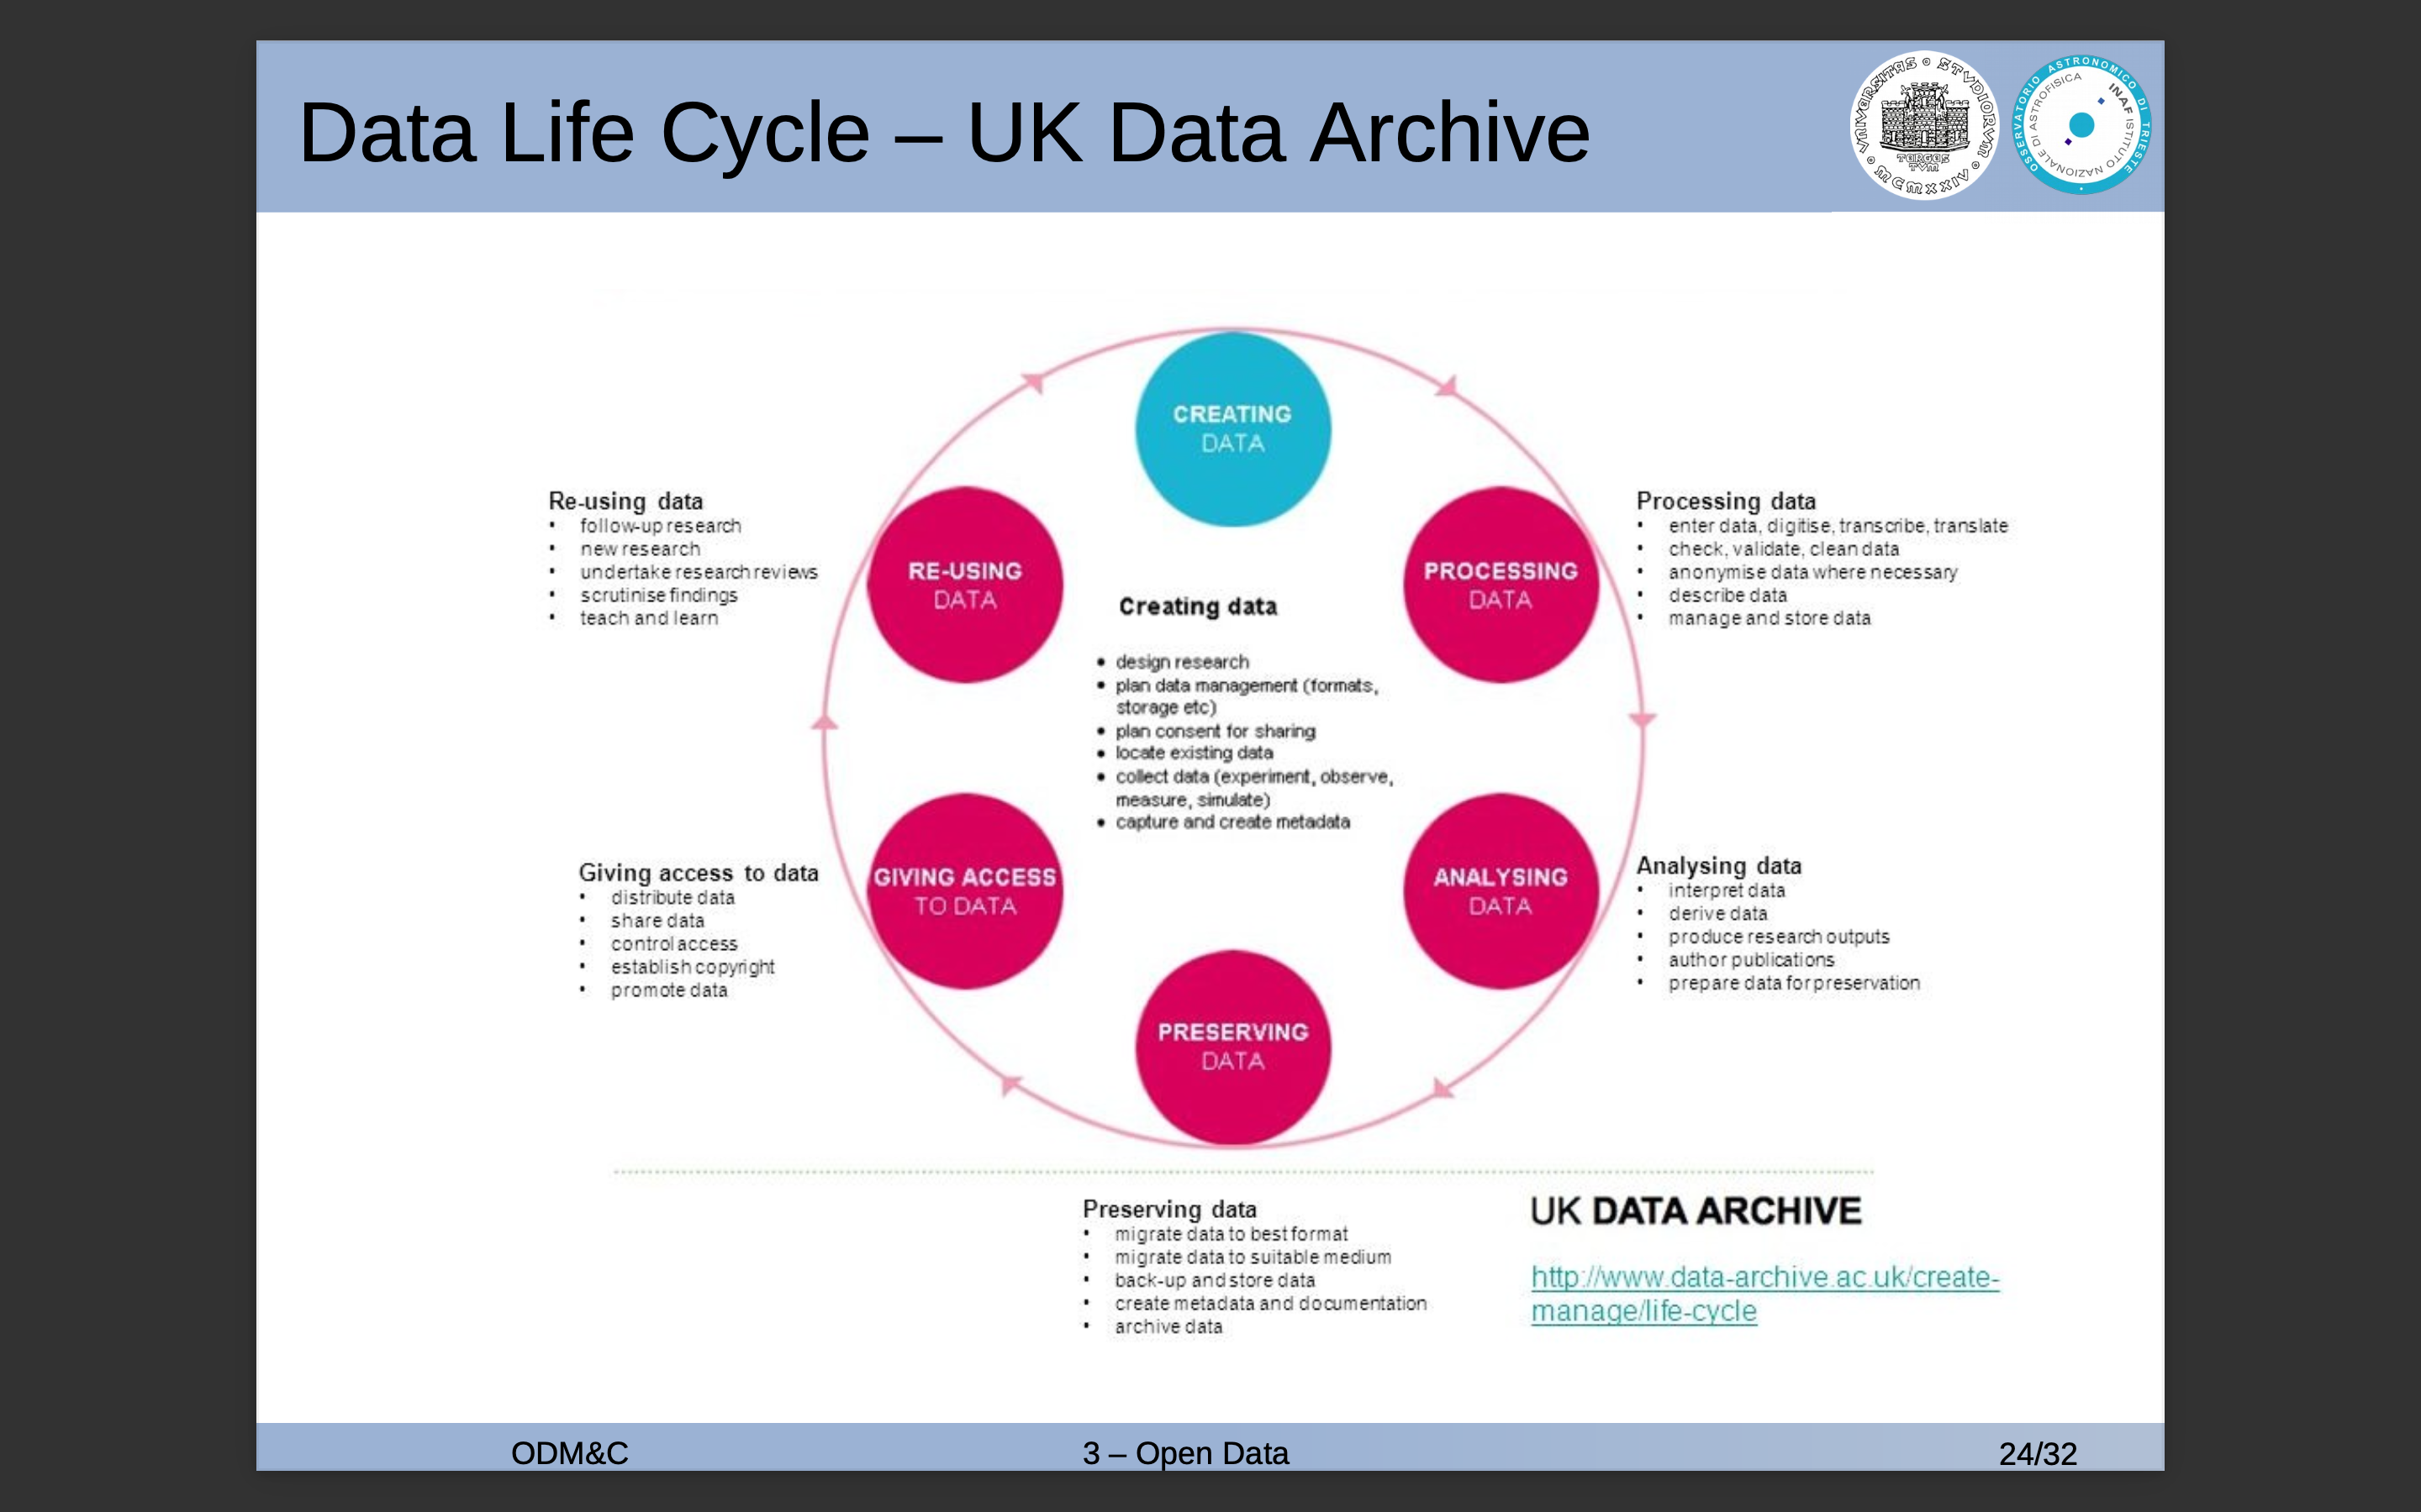

Slide 4
Nba data source
Data Source
Nba team and stats
Player and stats
Coaches
Kaggle combined data

Slide 5
RAW data
Data source
Data obtained in proprietary format : Microsoft Excel format
Data cleansing and validation
The raw data were processed to obtain additional derived data, very useful for future insight
Curated data were obtained by modifying outliers and repairing corrupted data
Data transformed into an open format : CSV & XLM
From curated data the model has been created

Slide 6
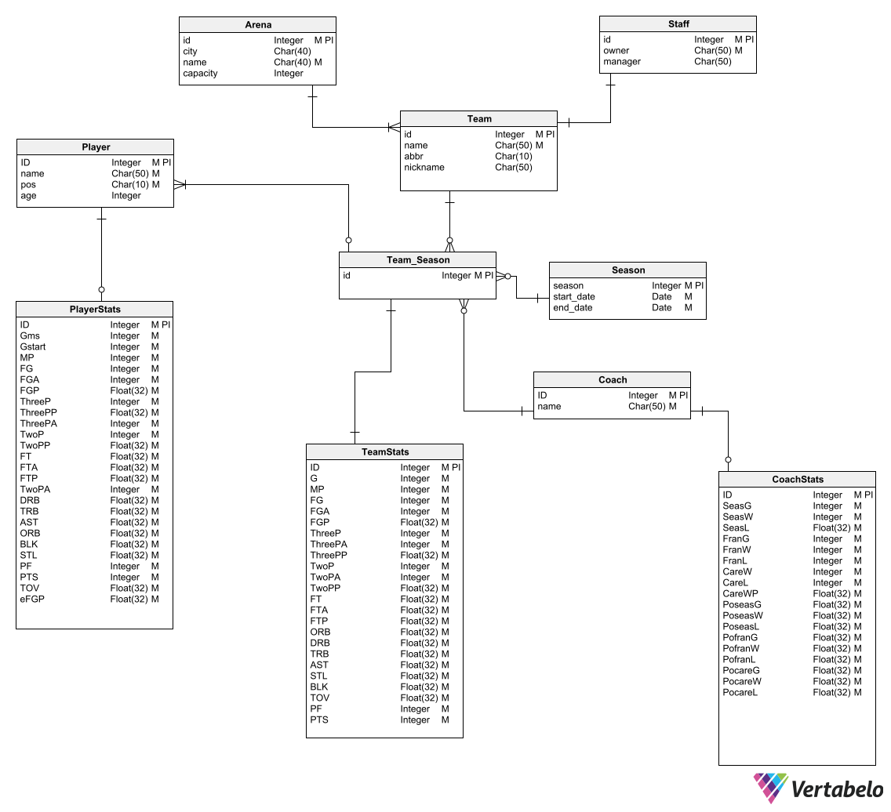
Logical data model
Data model
Logical model was created from the analysis of the curated data
With Vertabelo, automatic metadata & documentation associated to the logical model was generated
SnowFlakes Schema : 1 Fact Table - 5 Dimension
No data redundancy's
Fast Query
Less space necessary to store information

Slide 7
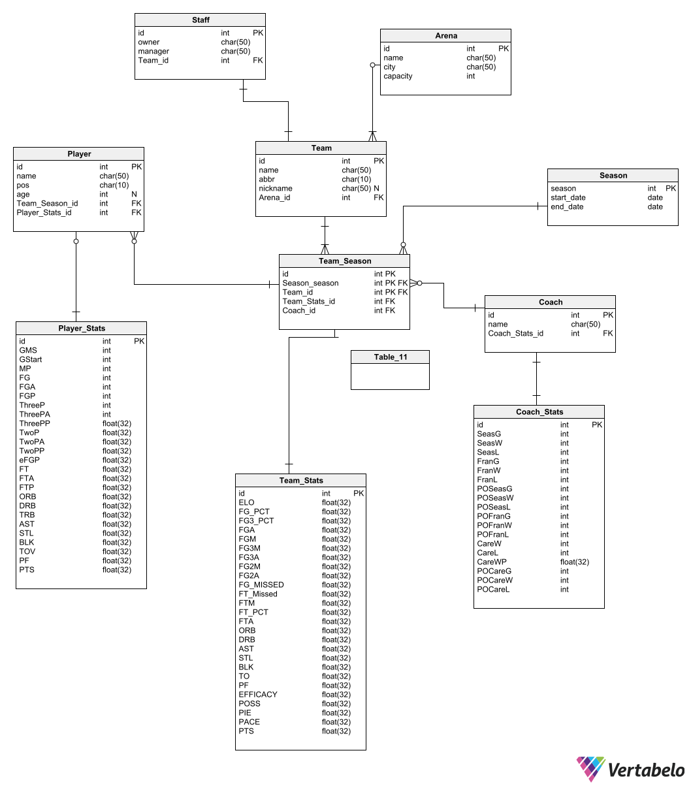
Physical Model & Implementation
Data modeling
Python with PonyORM
PostgresSQL 14
Metadata of physical model generated with Vertabelo
Relations managed with PonyORM via Optional, Required, Set properties
DDL generated from Postgres

Slide 8
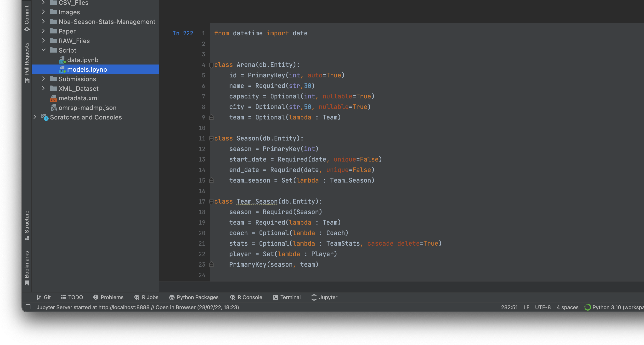
PonyORM model

Slide 9
Examples
Data inserted into DB via python script
FastAPI used to create RestAPI resource
HTTP GET operation available on resource

Slide 10
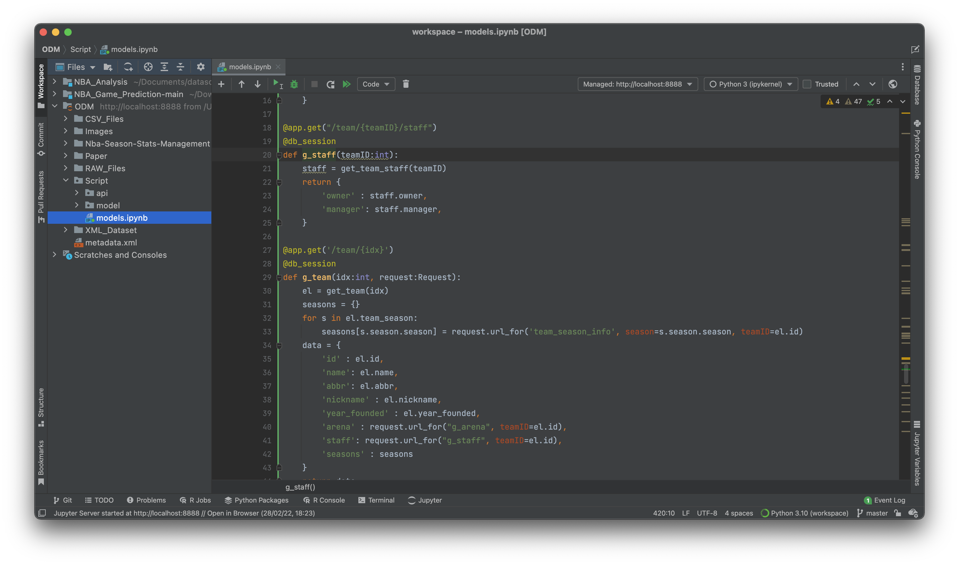

Slide 11
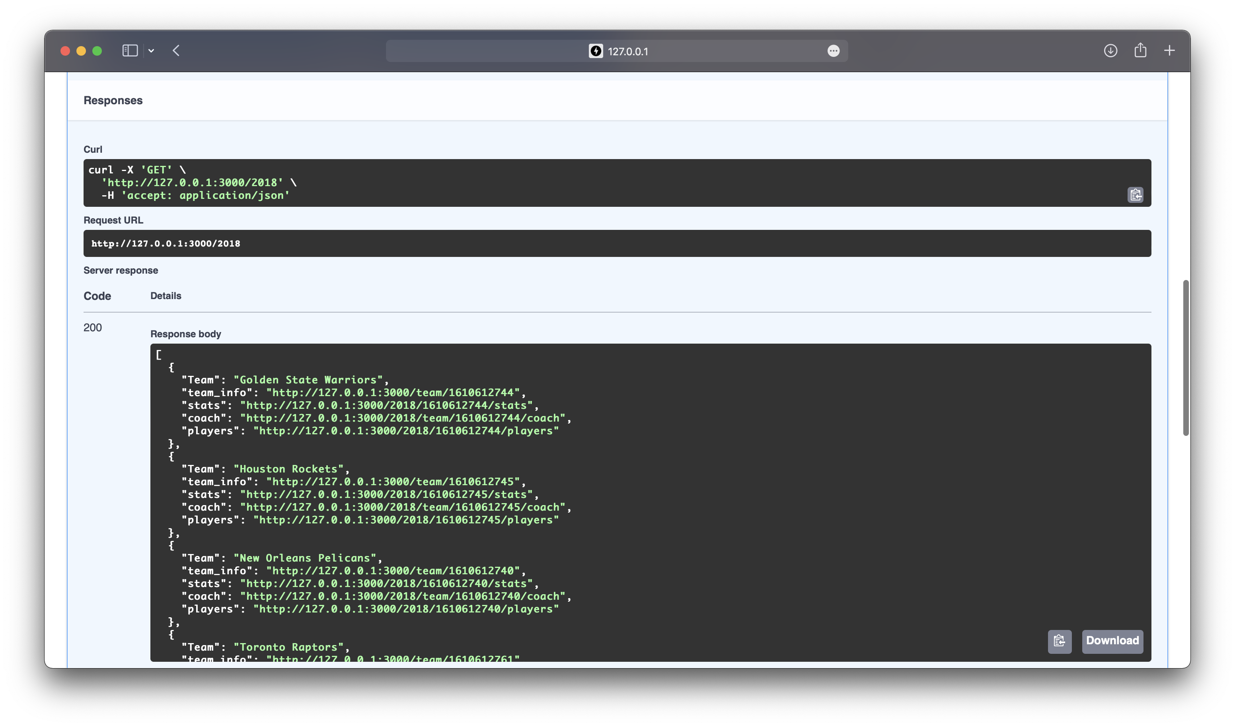

Slide 12
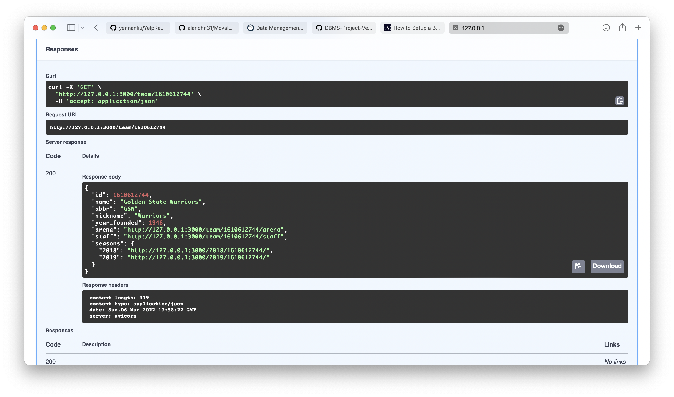

Slide 13
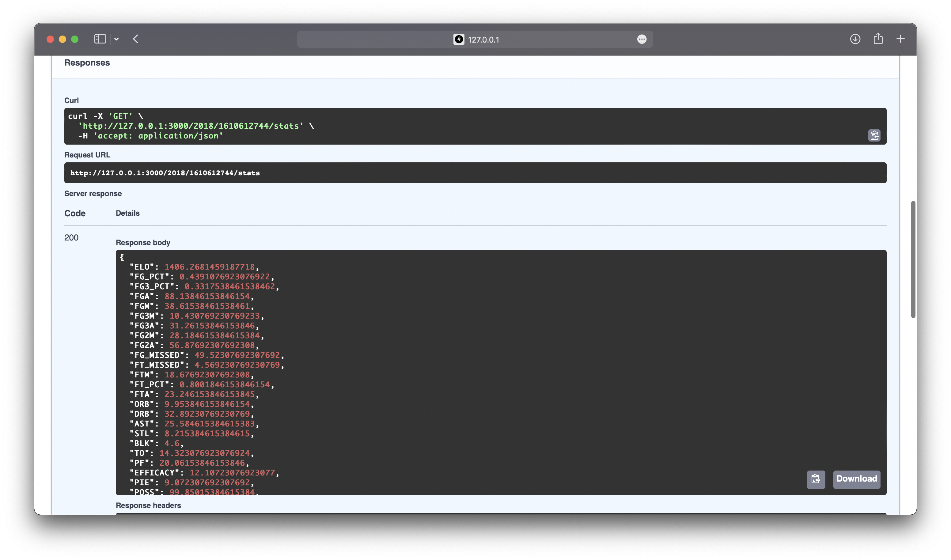

Slide 14
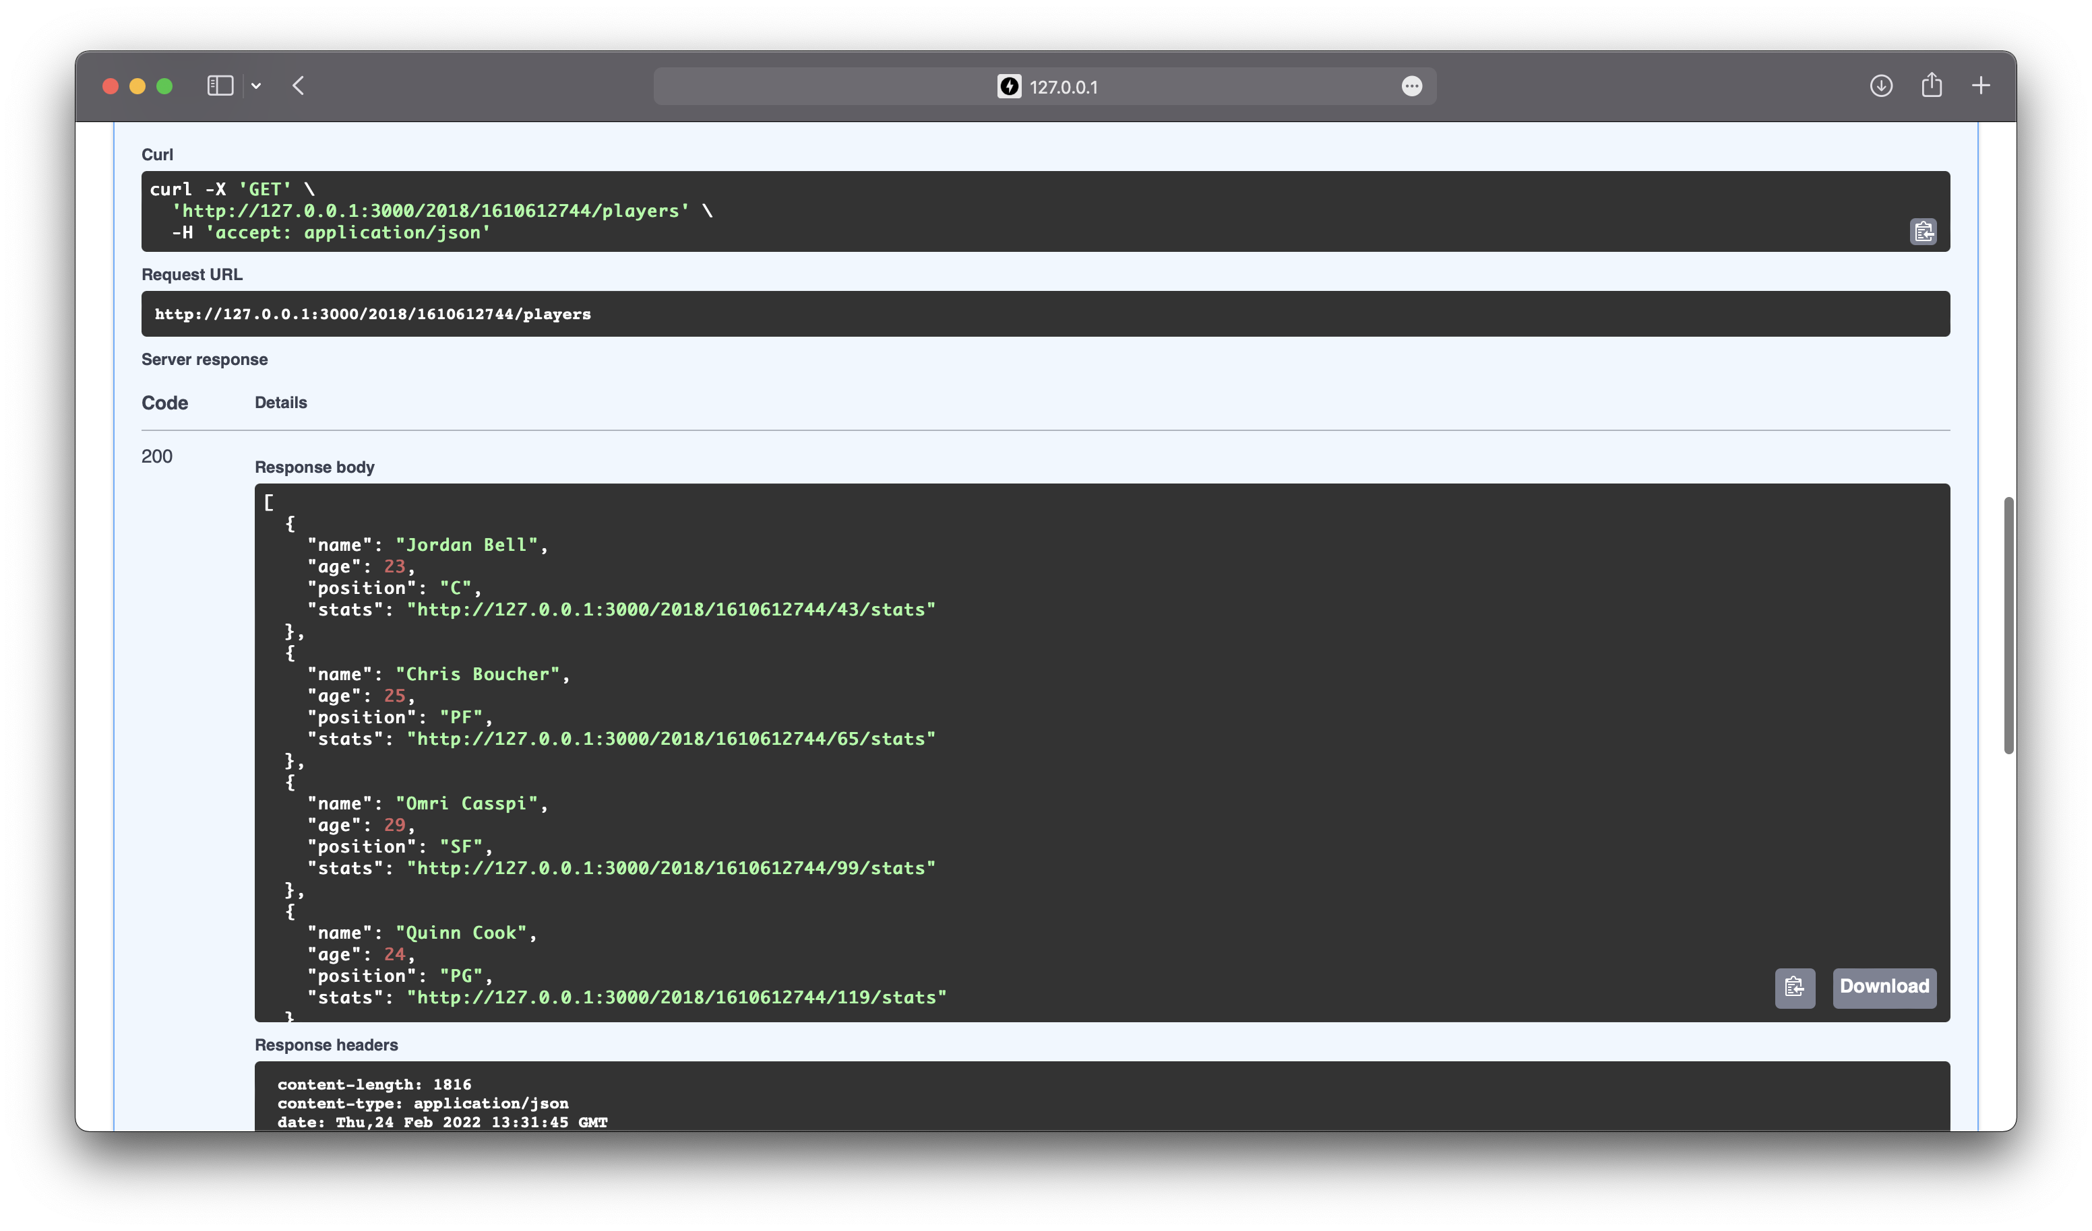

Slide 15
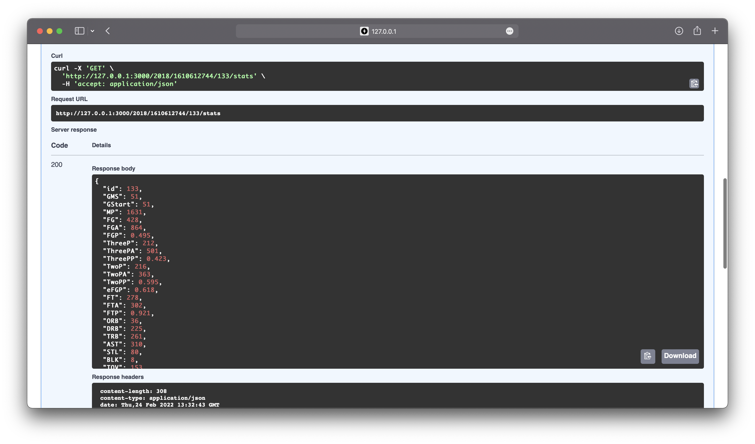

Slide 16
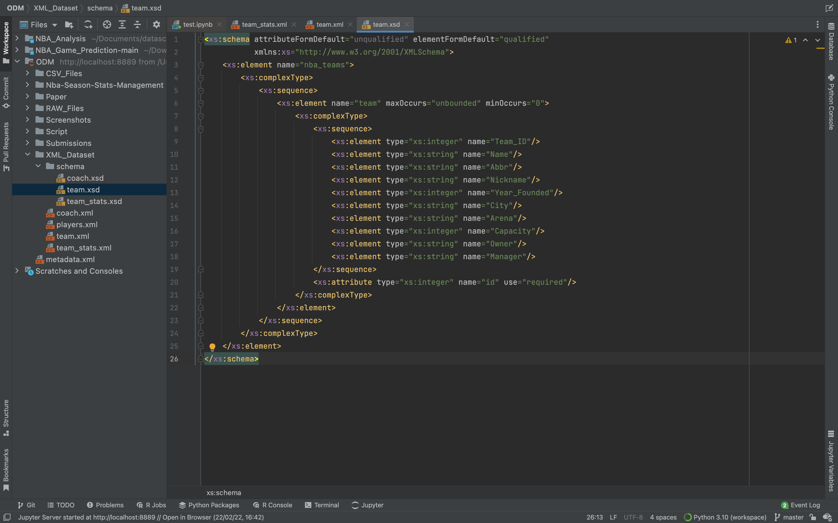
XML, XSD, CSV, db DUmp
Dataset
Data to publish available in CSV
… and also in XML format
XML follow XSD schema
Db dump available as artifact

Slide 17
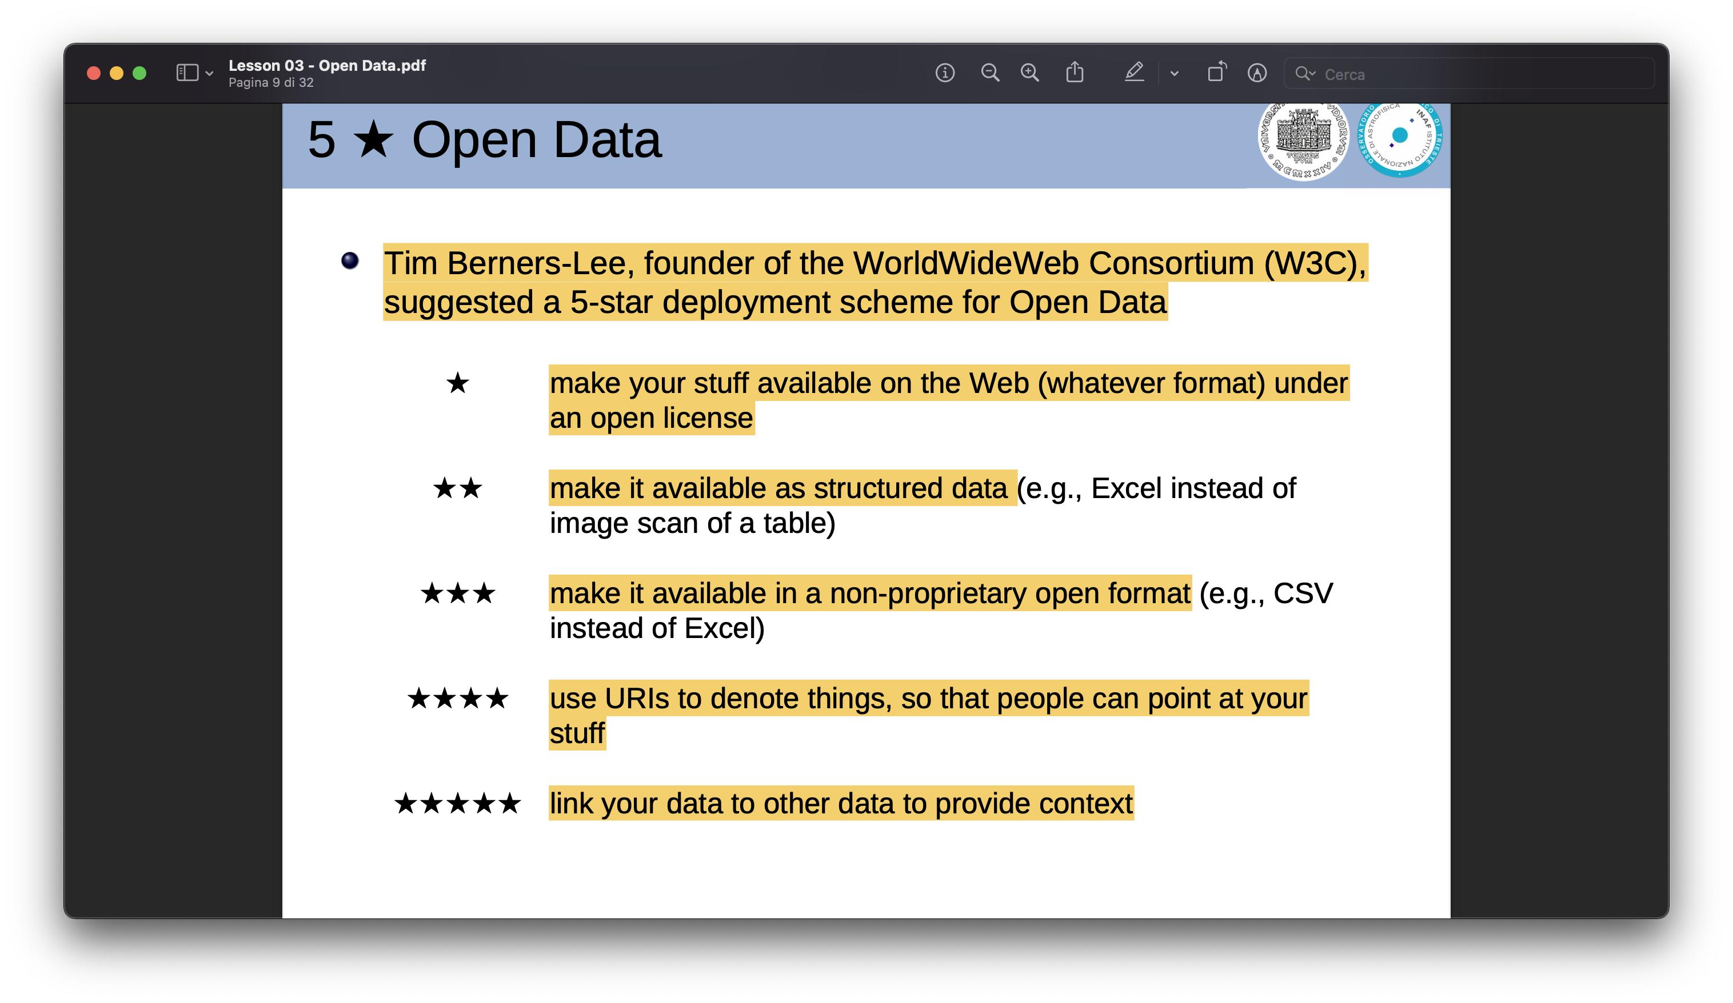
5 open data
Tim berners-lee scheme
Raw data available under open license
Curated data available as structured data
Curated data available in open format

Slide 18
Data management plan

Slide 19
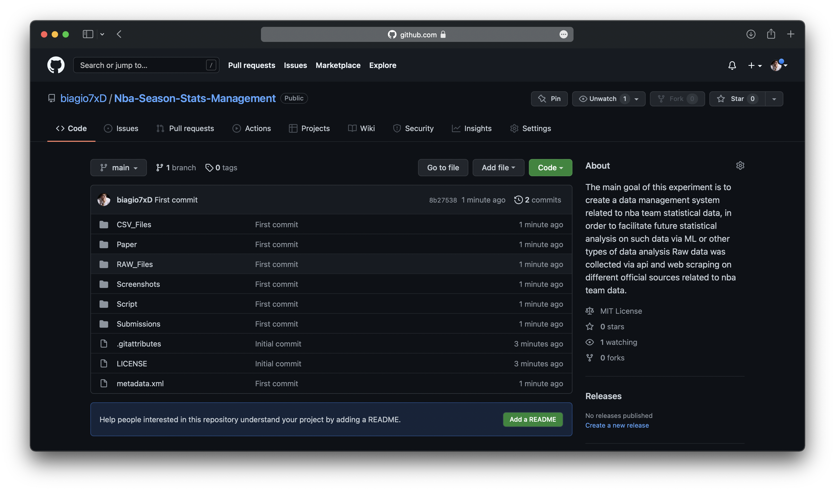
F - Findable
Fair data
The data and source code produced over the course of this project will adhair to the FAIR principles
Artifacts published to Zenodo, an open access repository
DOI : 27.6019/zenodo.229178
Github Repository
Both repository provide all the documentation and metadata

Slide 20
A - accessible
Fair data
All information about repository easily findable in data repository
Repository easily accessible via well-known World Wide Web
No access restrictions
Anyone can access, use, modify and reuse data

Slide 21
I - interoperable
Fair data
Use of open standard like CSV, PDF, XML etc..
No proprietary software is needed to read, modify or execute data
Use of Service Oriented Architecture open standard: RestAPI

Slide 22
R - reusable
Fair data
The reusability of the result data is ensured by the extensive documentation created for this data
Metadata available
Common Creative License

Slide 23
Data preservation
Preservation
Due to the small size of datasets consumed and produced, every piece of source code and documentation will be archived
The attached documentation contains a detailed list the specific files that are contained in this enumeration. This enables reproducing the results in any case
GitHub does not explicitly state the preservation time of their code repositories, but claims that it “(...) intends to keep your public repositories available unless you remove them” .
Zenodo is more specific and promises a retention period of its own lifetime, which amounts to at least the next 20 years

Slide 24

Cloud solutions
theoretical

Slide 25
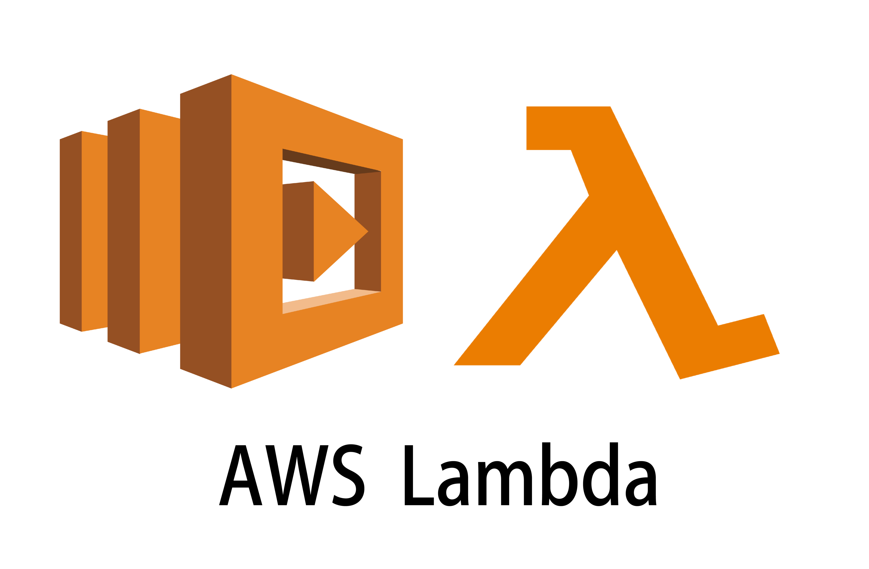
Amazon Aws lambda
Amazon Cloud Services
Function as a service
AWS Lambda is an event-driven, serverless computing platform provided by Amazon as a part of Amazon Web Services. It is a computing service that runs code in response to events and automatically manages the computing resources required by that code.
You can package your Lambda function code and dependencies as a container image, using tools such as the Docker CLI

Slide 26
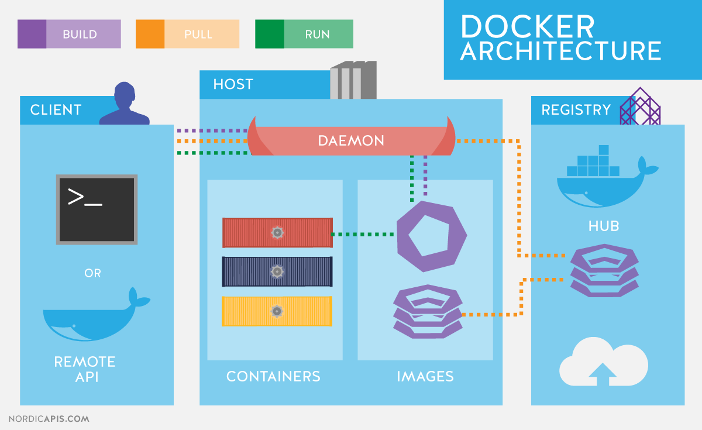
Docker container
Container
Packages up code and all dependencies to create portable software or scripts
Isolated Environment
Lightweight and easy to update
Full integration in AWS Lambda

Slide 27
Amazon s3
Amazon cloud services
Platform as a service
Store Raw data collected
Store Curated datasets
Backup/Replication of data

Slide 28
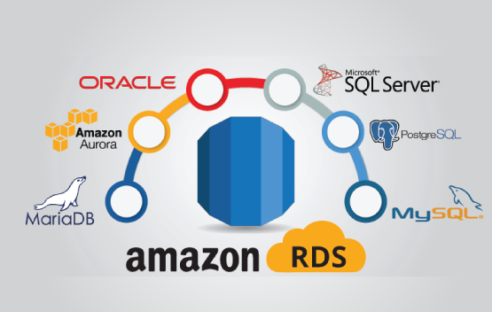
AMAZON aws rds
Amazon cloud Services
Amazon Relational Database Service (or Amazon RDS) is a distributed relational database service by Amazon Web Services (AWS)
It is a web service running "in the cloud" designed to simplify the setup, operation, and scaling of a relational database for use in applications
Platform as a service
Connected to AWS Lambda to provide RestAPI data access

Slide 29
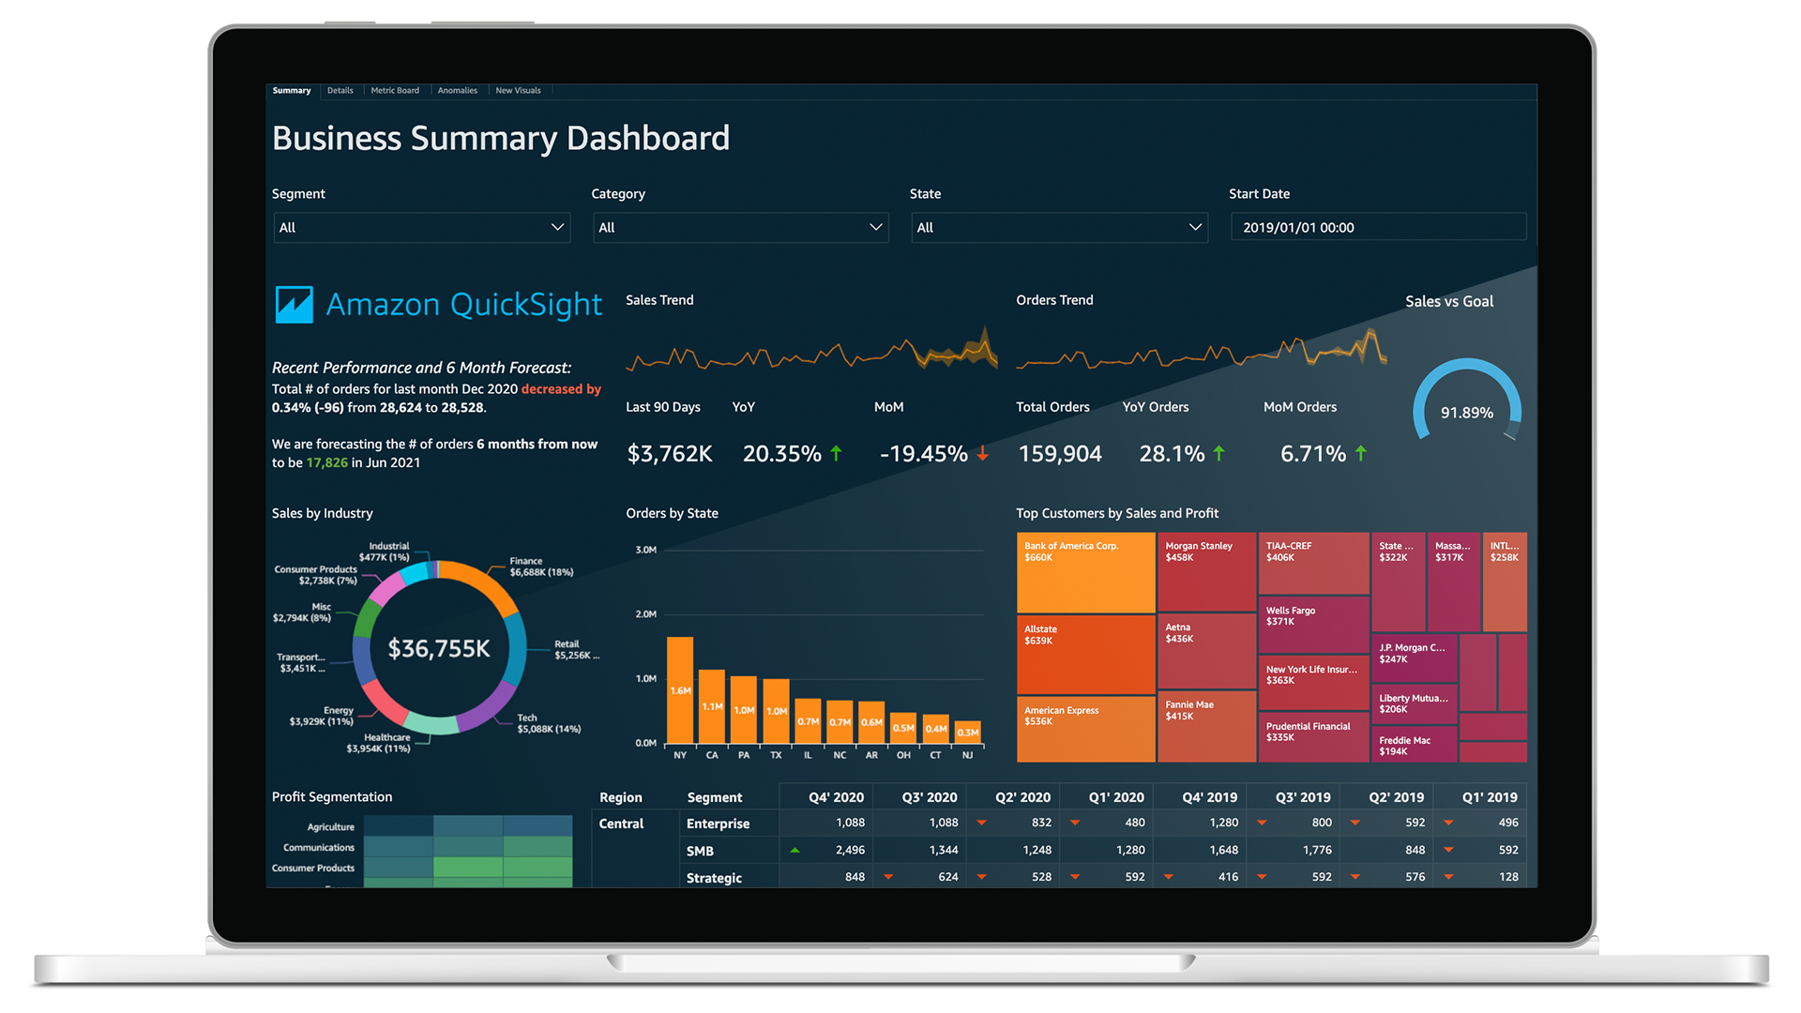
Amazon AWS quicksight
Amazon Cloud Services
Amazon QuickSight is a cloud-scale business intelligence (BI) service that you can use to deliver easy-to-understand insights
Well integrated with other amazon aws services
Software as a service

Slide 30
Thank you.

